Slide 1

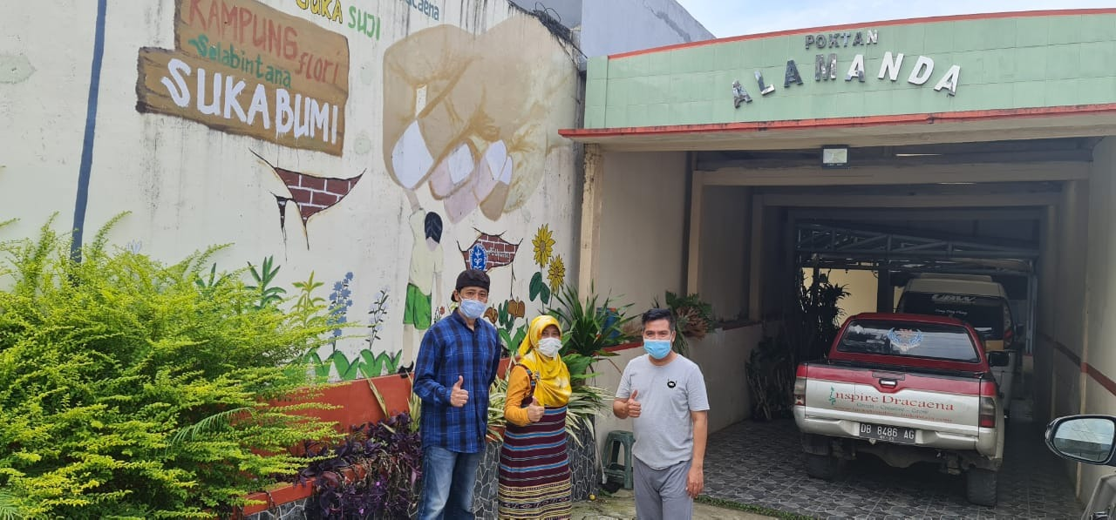
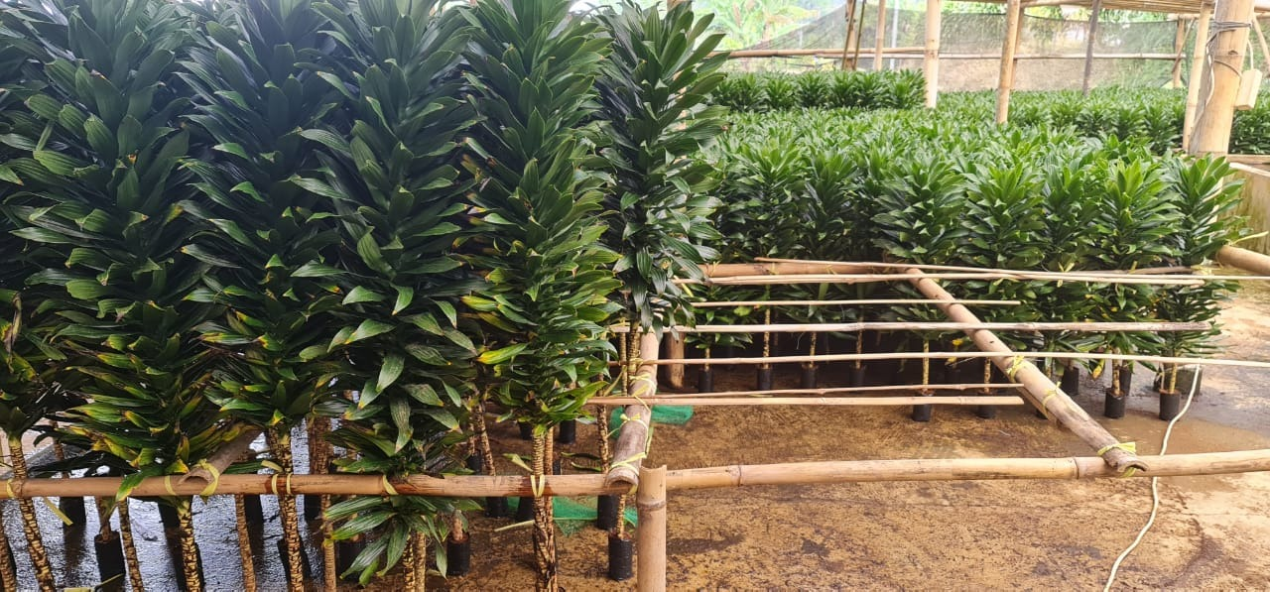
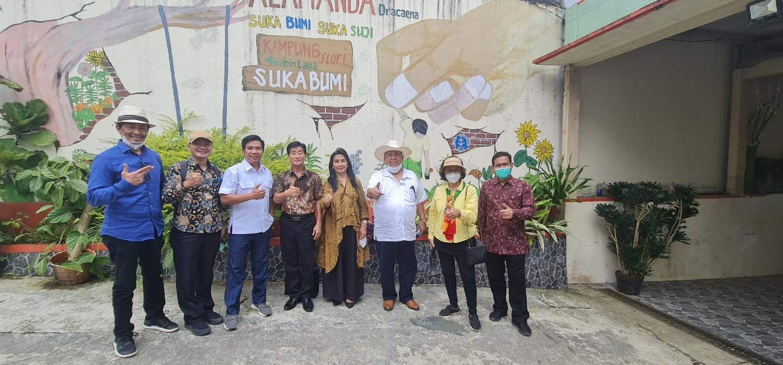
Strategi Pengembangan Kelembagaan Korporasi Tanaman Hias
Prof M. Firdaus, PhD
14 Juli 2021

Slide 2

Outline
CV
Perkembangan Perdagangan Pertanian Selama Pandemi Covid-10
Prospek Pasar Florikultura di Pasar Global
Pengembangan Korporasi Petani Florikultura

Slide 3
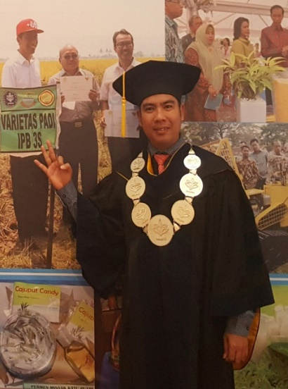
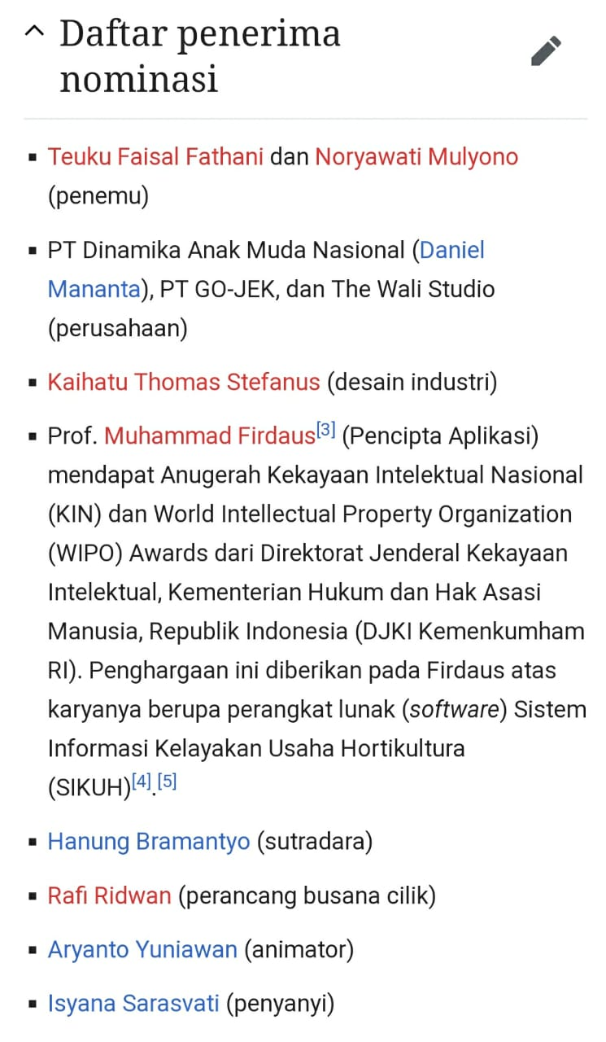

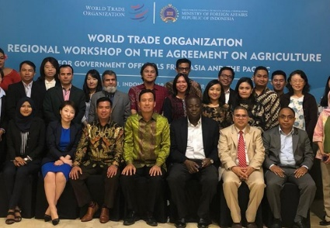

CV
Guru Besar Ilmu Ekonomi FEM – IPB University
Peraih KI and WIPO Award 2016

Slide 4
Perkembangan Perdagangan Pertanian Selama Pandemi Covid-10

Slide 5
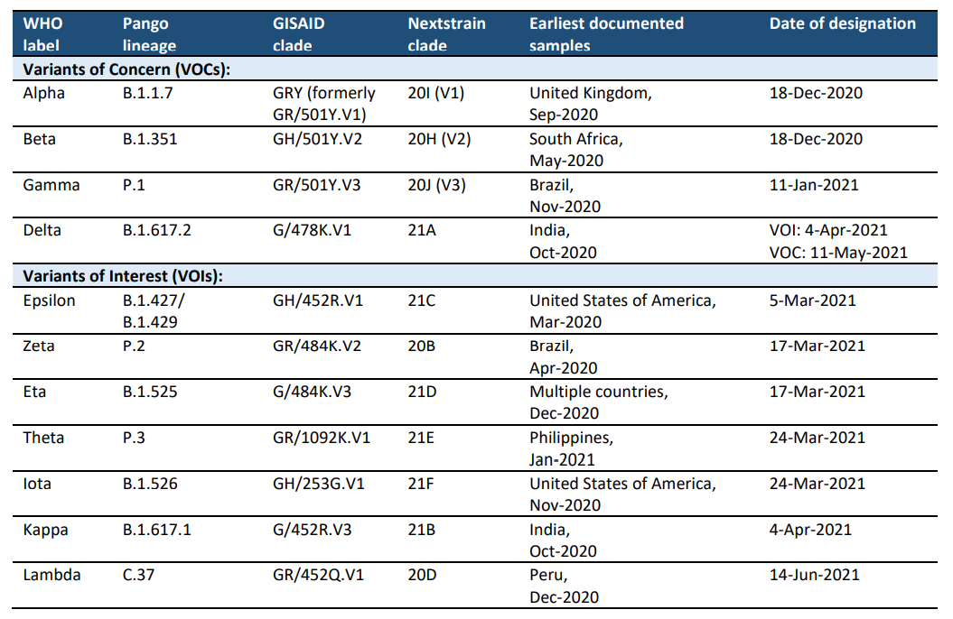
Update of Covid-19 as of 12 July 2021
Globally, as of 12 July 2021, there have been 186.411.011 confirmed cases of COVID-19: 4.031.725 deaths

Slide 6
Impact of Pandemic Covid-19 and Strategic Responses
Production activity Lower economic growth: Tourism, Horeca, Agric, Manufacturing & informal sector
Investment: e.g. China dominated in Eastern Indonesia
Trade: Global recession discourages trade flows

Slide 7
Impact of Pandemic Covid-19 and Strategic Responses
Variable | Coefficient | Se | P-Value
GDP | 1.806586 | 0.194238 | 0.0000
Population | 1.215334 | 0.147391 | 0.0000
Exchange Rate | -0.239713 | 0.059489 | 0.0001
Tariff | -0.156521 | 0.055092 | 0.0050
Distance | -1.351730 | 0.136291 | 0.0000
Constant | -54.08620 | 4.051198 | 0.0000
R-squared | 0.819102
Adjusted R-sq | 0.814078
F-statistic | 163.0077
Prob(F-statistic) | 0.000000
Using SPATIAL model to estimate determinants of export in a region
ECONOMIC ATIVITY IS THE MAIN PULL FACTOR
Source: Firdaus, et. al, 2019

Slide 8
Impact of Pandemic Covid-19 and Strategic Responses
Strategic Responses (ASEAN Policy Brief, April 2020):
Mobilizing all available macro, financial, and structural policy tools
Preserving the economy’s productive capacity: diversity of production and export bases. AGRICULTURE IS THE RESCUER OF INDONESIA ECONOMY 2020
Keeping the supply chains going
Leveraging on technologies and digital trade
Strengthening the social safety nets
Scaling-up regional pandemic responses
Redoubling the resolve to advance regional integration

Slide 9
AGRICULTURAL MARKETS AND TRADE DURING PANDEMIC (FAO, 2021)
The COVID-19 pandemic and the measures to control its spread affected the global trading system, domestic and international supply chains and food demand alike. In response to concerns over food security and food safety worldwide, many countries immediately imposed policy measures with the aim to curb potentially adverse impacts on their agricultural markets, producers and consumers. Despite disruptions, global food commodity markets and agricultural trade have proved resilient to the COVID-19 shock. Agricultural trade has continued to flow, global markets continue to be well supplied and prospects are favourable, at least for basic foodstuffs. The full economic and social impacts are still unfolding and as the disease continues to spread, COVID-19 will continue to be a serious source of market uncertainty with implications for demand and supply of food and agricultural commodities.

Slide 10
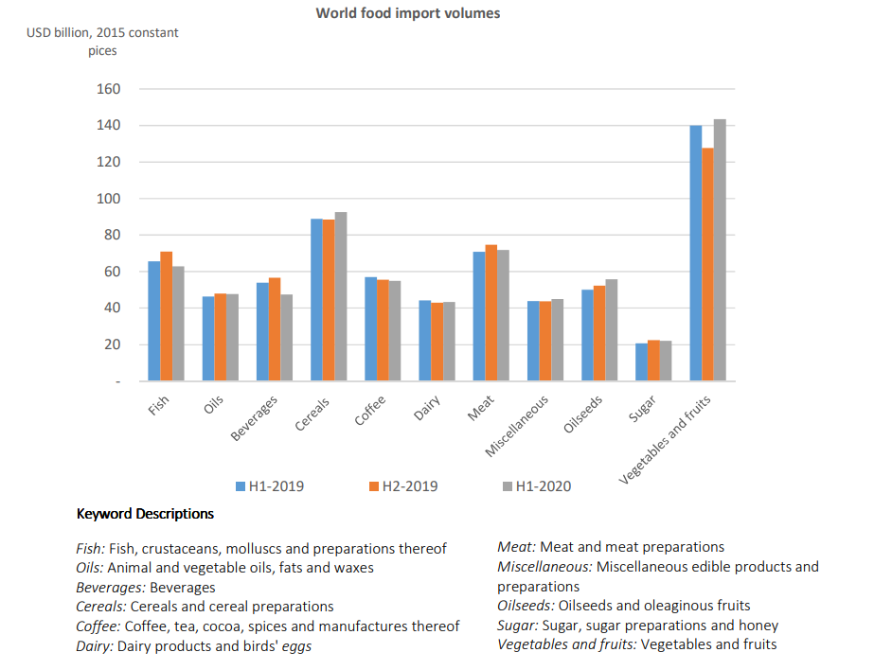
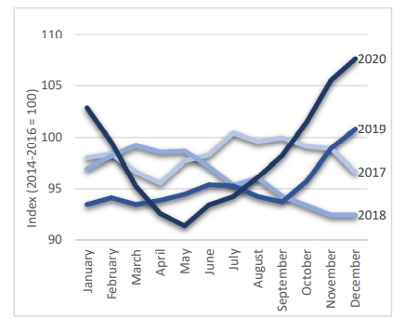
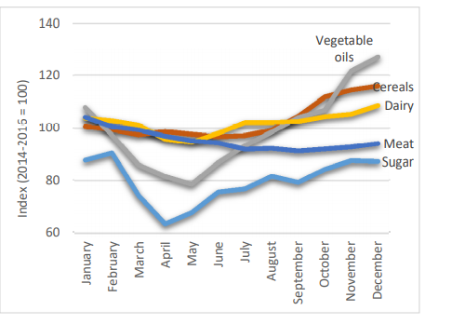
Agriculture Trade During Pandemic
FAO report:

Slide 11
Prospek Pasar Florikultura
di Pasar Global

Slide 12
Indonesia Trade Flow During Pandemic (million USD)
COMMODITY EXPORT | 2016 | 2017 | 2018 | 2019 | 2020 | Trend(%)
VEGETABLE OIL | 18,233.5 | 22,966.5 | 20,348.1 | 17,634.8 | 20,716.4 | -0,09
RUBBER AND PRODUCTS FROM RUBBER | 5,664.2 | 7,740.7 | 6,380.1 | 6,025.6 | 5,618.8 | -2,63
COFFEE, TEEA, SPICES | 1,896.5 | 1,964.7 | 1,550.0 | 1,618.9 | 1,719.8 | -3,82
FOOD PROCESSING PRODUCTS | 949 | 1,027.1 | 1,184.9 | 1,309.4 | 1,274.1 | 8,68
COCOA | 1,239.6 | 1,120.3 | 1,245.8 | 1,198.7 | 1,244.2 | 0,75
TOBACCO | 1,009.7 | 1,141.8 | 1,203.5 | 1,207.8 | 1,150.6 | 3,23
FLOUR PRODUCTS | 814 | 969,4 | 1,016.3 | 1,056.5 | 1,150.0 | 8,08
FOOD IDUSTRY WASTE | 553,7 | 604,5 | 801,7 | 802,3 | 983,4 | 15,40
FRUITS | 712 | 936,2 | 825,2 | 797,4 | 934,3 | 3,90
DAIRY PRODUCTS | 229,7 | 316,9 | 333,8 | 417,1 | 597,1 | 24,43
OILY SEREALS | 268,5 | 254,5 | 338,6 | 324,8 | 307 | 5,26
VEGETABLES | 93,6 | 104,3 | 105,1 | 121,4 | 166 | 13,84
LIVE ANIMALS | 57,3 | 64 | 60,9 | 65,9 | 80,4 | 7,32
ANIMAL PRODUCTS | 18,1 | 22,7 | 20,9 | 21,9 | 24,1 | 5,48
LIVE PLANTS, CUT FLOWER | 20,9 | 17,6 | 18,6 | 17,8 | 18,5 | -2,30
WHEATS | 12,1 | 4,4 | 75 | 1,6 | 17,5 | -2,50
MEAT AND FISH | 20,7 | 18,1 | 16 | 17,1 | 14,2 | -7,78
LEATHER | 1,4 | 0,8 | 0,3 | 0,5 | 0,3 | -33,38

Slide 13
Indonesia Trade Flow During Pandemic (million USD)
COMMODITY IMPORT | 2016 | 2017 | 2018 | 2019 | 2020 | Trend(%)
WHEATS AND WHEAT PRODUCTS | 3,191.8 | 2,927.2 | 3,795.0 | 3,237.3 | 3,021.8 | -0,09
FOOD INDUSTRY WASTE | 2,479.9 | 2,652.2 | 3,057.4 | 2,649.4 | 2,910.8 | 3,24
OILY SEREALS | 1,202.9 | 1,503.6 | 1,515.8 | 1,489.5 | 1,420.6 | 3,29
COTTON | 2,096.2 | 2,261.8 | 2,396.8 | 1,974.9 | 1,327.7 | -9,96
FRUITS | 848,1 | 1,191.6 | 1,310.9 | 1,486.0 | 1,271.5 | 10,86
DAIRY PRODUCTS | 832,4 | 990,5 | 1,014.5 | 1,143.4 | 1,156.6 | 8,34
VEGETABLES | 695,9 | 820,7 | 738,4 | 770,1 | 846,4 | 3,34
FOOD PROCESSING PRODUCTS | 666,5 | 731,9 | 900,9 | 824,7 | 818,7 | 5,45
TOBACCO | 541,2 | 704,5 | 793,6 | 689,7 | 664,3 | 3,96
COCOA | 350,4 | 646,3 | 706,8 | 776 | 650,7 | 15,27
FLOUR PRODUCTS | 314,9 | 353,3 | 404,3 | 487,5 | 477,8 | 12,25
LIVE ANIMALS | 616,1 | 548,4 | 608,9 | 631,1 | 471 | -3,89
COFFEE, TEA AND SPICES | 228,4 | 254 | 392,5 | 262,2 | 233,2 | 0,74
VEGETABLE OILS | 179,4 | 198,8 | 207,9 | 250,9 | 220,7 | 6,68
FRUITT AND VEGETABLE PRODUCTS | 172,9 | 198 | 208,2 | 224,8 | 197,8 | 4,04
PRODUCTS FROM ANIMALS | 91,1 | 118,2 | 162,4 | 171,9 | 149,1 | 14,58
WOLL | 147,3 | 111,3 | 124,3 | 114,6 | 44,9 | -20,93
LIVE PLANTS | 4,5 | 5,9 | 7,2 | 9,3 | 8 | 17,59

Slide 14
Keunggulan Florikultura
:
Nilai ekonomi tinggi (benefit-cost ratio jauh di atas komoditas lain)
Menyerap TK secara intensif (SOP dan bisa panen setiap bulan)
Konsumsi terus meningkat ke depan karena kenaikan pendapatan
Permintaan terus naik karena healthy soul an WFH
NAMUN masih kurang diperhatikan (selain BABE), karena tidak
se”politik” beras, atau belum se”ekonomi” sawit

Slide 15
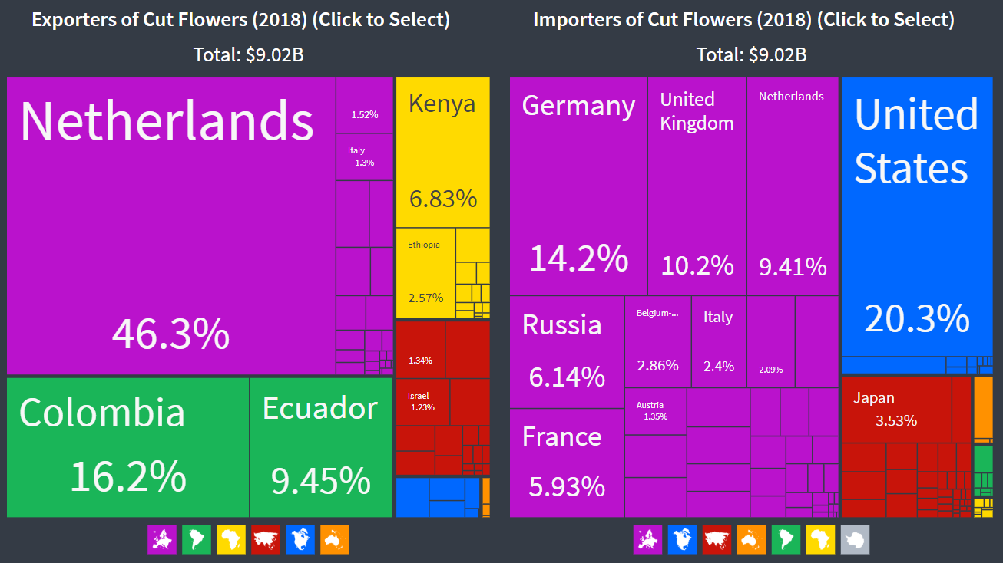
Pasar Bunga Potong Global
In 2018, Cut Flowers were the world's 350th most traded product, with a total trade of $9.02B. Between 2017 and 2018 the exports of Cut Flowers grew by 6.31%, from $8.48B to $9.02B. Trade in Cut Flowers represent 0.049% of total world trade.

Slide 16
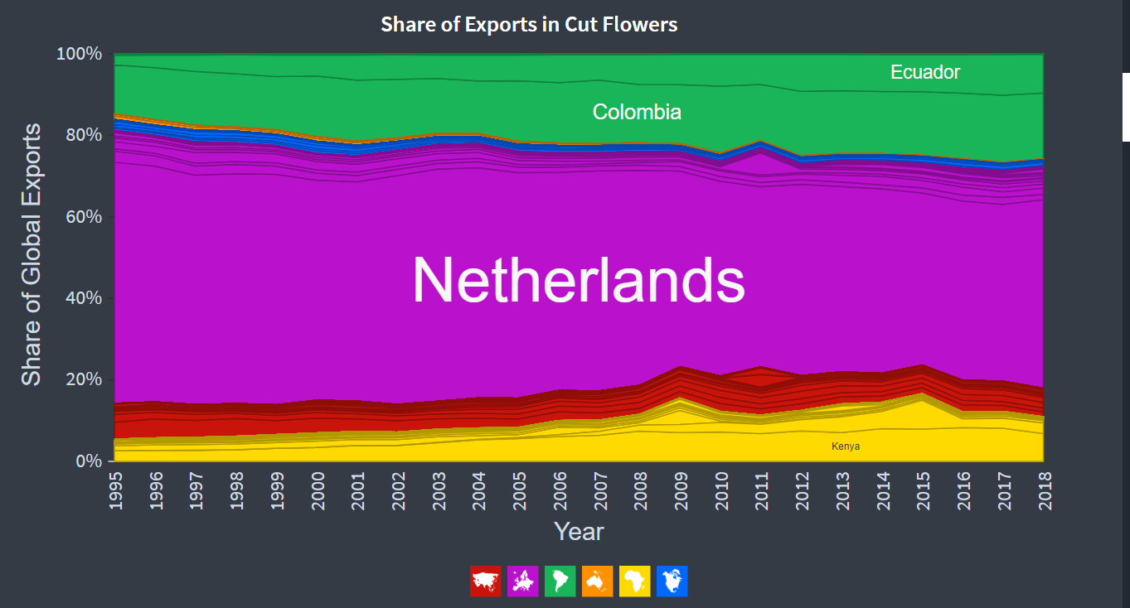
Pasar Bunga Potong Global
In 2018, market concentration measured using Shannon Entropy, was 3.05. This means that most of the exports of Cut Flowers are explained by 8 countries.

Slide 17
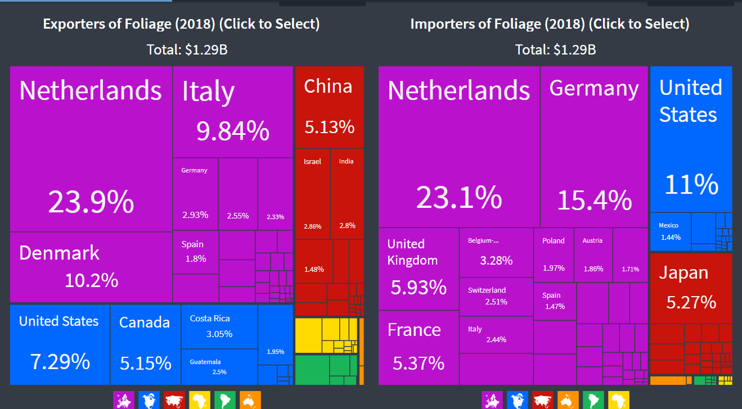
Pasar Tanaman Hias Daun (Foliage) Global
In 2018, Foliage were the world's 847th most traded product, with a total trade of $1.29B. Between 2017 and 2018 the exports of Foliage grew by 10.7%, from $1.16B to $1.29B. Trade in Foliage represent 0.007% of total world trade.

Slide 18
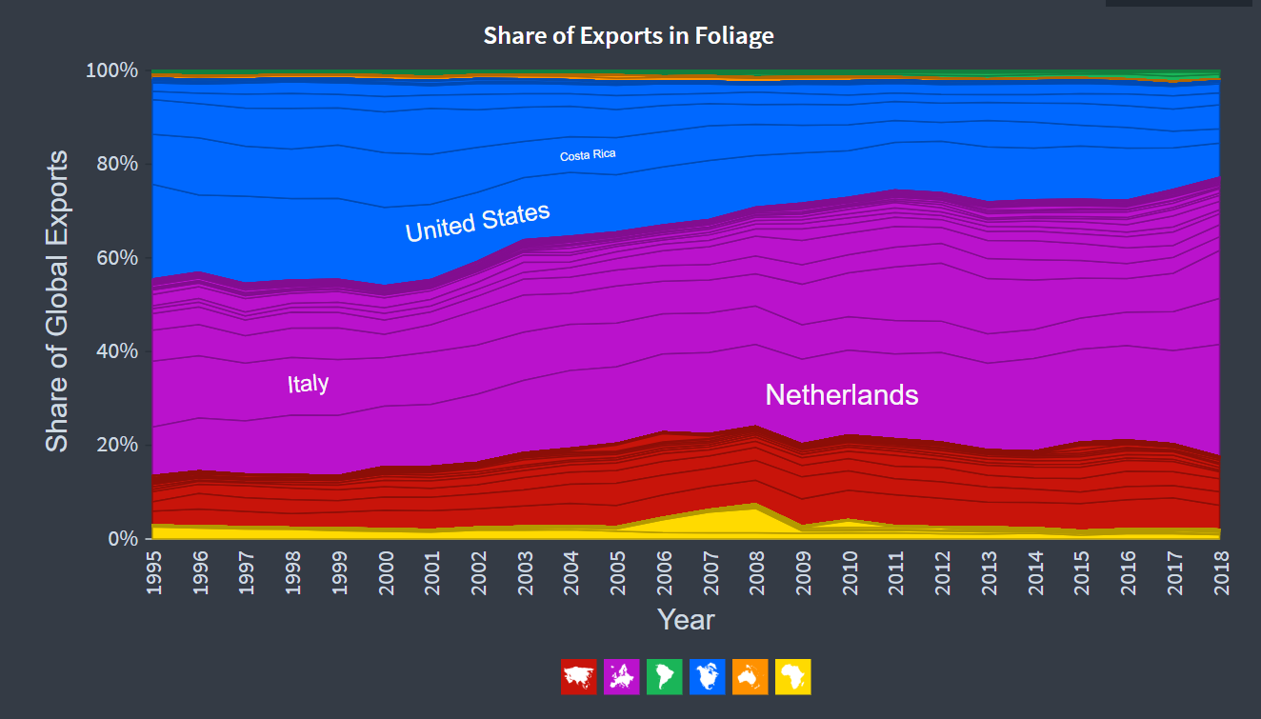
Pasar Tanaman Hias Daun (Foliage) Global
In 2018, market concentration measured using Shannon Entropy, was 4.31. This means that most of the exports of Foliage are explained by 19 countries.

Slide 19
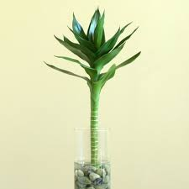
Implikasi Data Pasar Global bagi Indonesia
:
Struktur pasar bunga potong lebih ketat daripada TH daun
Indonesia perlu mencari keunggulan komparatif: TH daun atau eksotik
Pengusahaan flori harus menyasar ke daerah dengan upah TK rendah
SDM harus disediakn secara sengaja
Kebijakan harus mendukung penuh pengembangan flori

Slide 20
Pengembangan Korporasi
Petani Florikultura

Slide 21
Pengembangan Kawasan Berbasis Korporasi Petani
:
Pengertian
(Permentan No. 18/ 2018)
Kelembagaan Ekonomi Petani berbadan hukum berbentuk koperasi atau badan hukum lain dengan sebagian besar kepemilikan modal dimiliki oleh petani
Prinsip
Kesatuan badan usaha yang dibentuk dari, oleh dan untuk petani
Korporasi petani merestorasi jiwa gotong royong petani
Usaha tani didukung oleh korporasi dan sebaliknya
Korporasi petani meningkatkan kesejahteraan petani
Jangkauan: kabupaten,
propinsi atau nasional
PP no. 18/2020 tentang RPJMN
(Lampiran III)

Slide 22
Dampak Pengembangan Korporasi Petani
:
Gurem
Takut pada risiko
Sumberdaya internal terbatas
Tidak akses pada modal luar
Tidak cakap dalam bisnis
Keputusan di tingkat RT
Sulit untuk bekerjasama
Fleksibilitas perenanaan kurang dari 1 mingu
Agribisnis
Berani pada risiko
Sumberdaya internal cukup
Akses pada modal luar
Cakap dalam bisnis
Keputusan di korporasi
Membutuhkan koperasi
Fleksibilitas perencanaan lebih dari 6 bulan

Slide 23
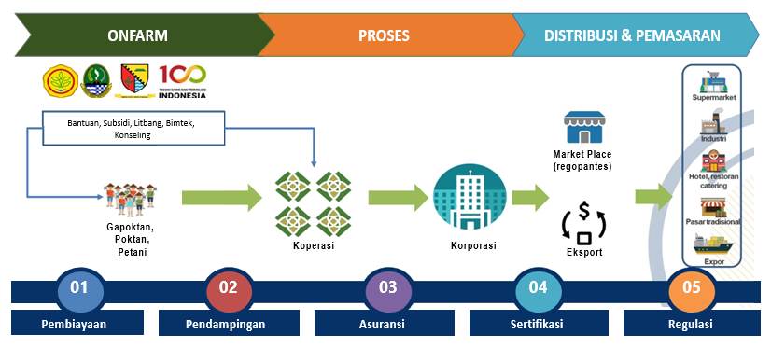
Model Bisnis Korporasi Petani
:

Slide 24
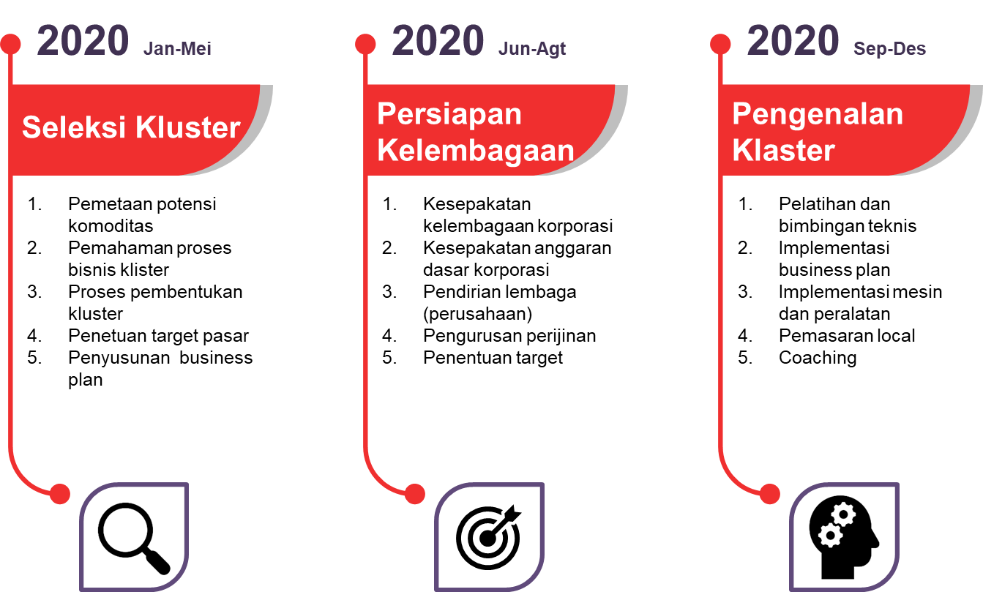
Tahapan Pengembangan Korporasi Petani Florikultura
:
2021, Juli-Okt
2021, Nov-Des
2022, Jan-Mar

Slide 25
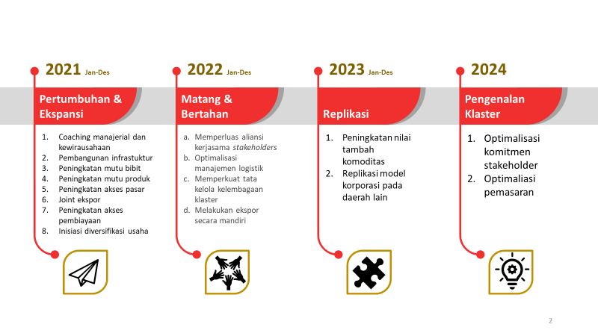
Tahapan Pengembangan Korporasi Petani Florikultura
:
2022, Apr-Des
2023, Jan-Juni
2023, Juli-Des
2024, Jan

Slide 26
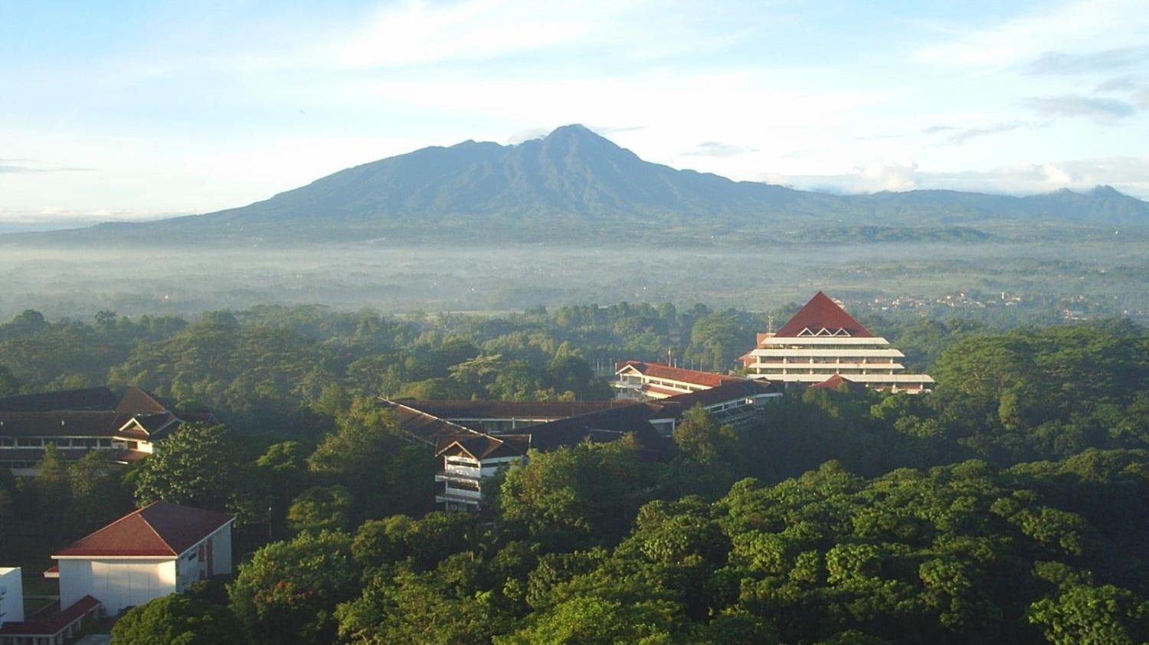

Hatur Nuhun
Department of Economics - IPB University
IPB Dramaga Campus, Bogor 16680
Telp.: 0251-8622602
E-mail: ilmu_ekonomi@ipb.ac.id
Web : http://ilmuekonomi.fem.pb.ac.id

